Slide 1
E-COMMERCE ANALYTICS
By Ajay Patel

Slide 2


PROBLEM STATEMENT
Businesses struggle to track sales, profit, returns, and funnel in one place.
Objective: Build a 360° analytics dashboard to support leadership decisions.

Slide 3
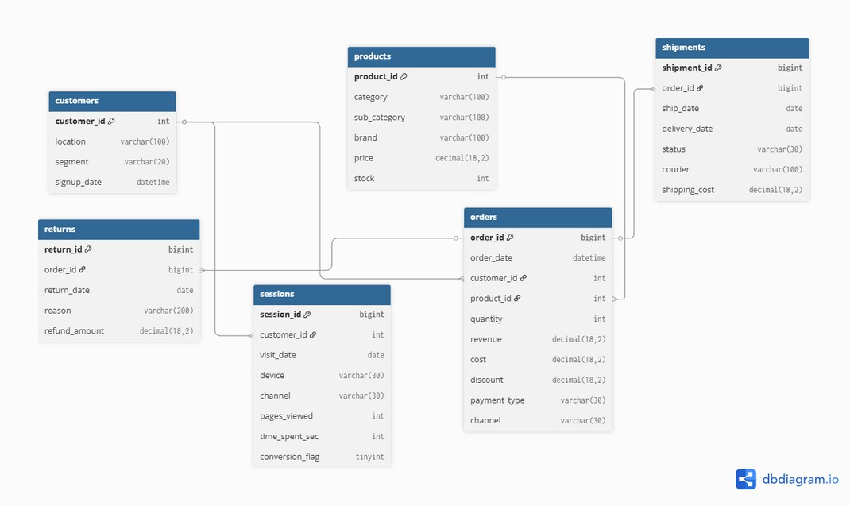
DATA PIPELINE
Python → Cleaning & KPI prep
SǪL → Schema & Analytical Ǫueries
Power BI → Dashboard for Executives

Slide 4
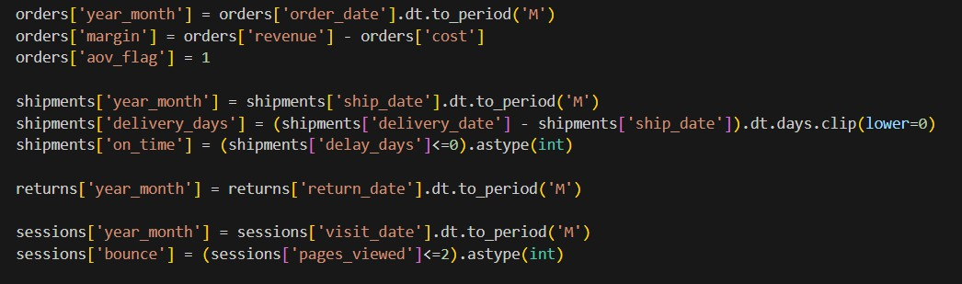
PYTHON HIGHLIGHTS
Cleaned raw CSVs & derived KPIs (margin, delivery days, bounce rate).
Exported BI-ready data into SǪL.

Slide 5
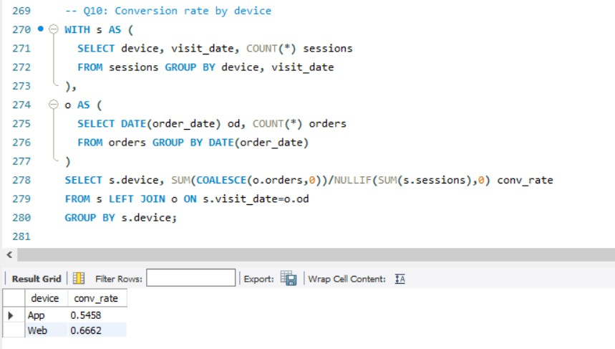
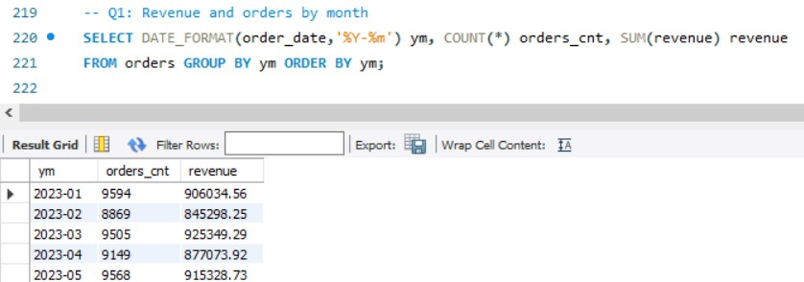
SQL HIGHLIGHTS
Revenue & Orders trend by month. Conversion rate by device (App vs Web).
30+ SǪL queries & BI views for KPIs.

Slide 6
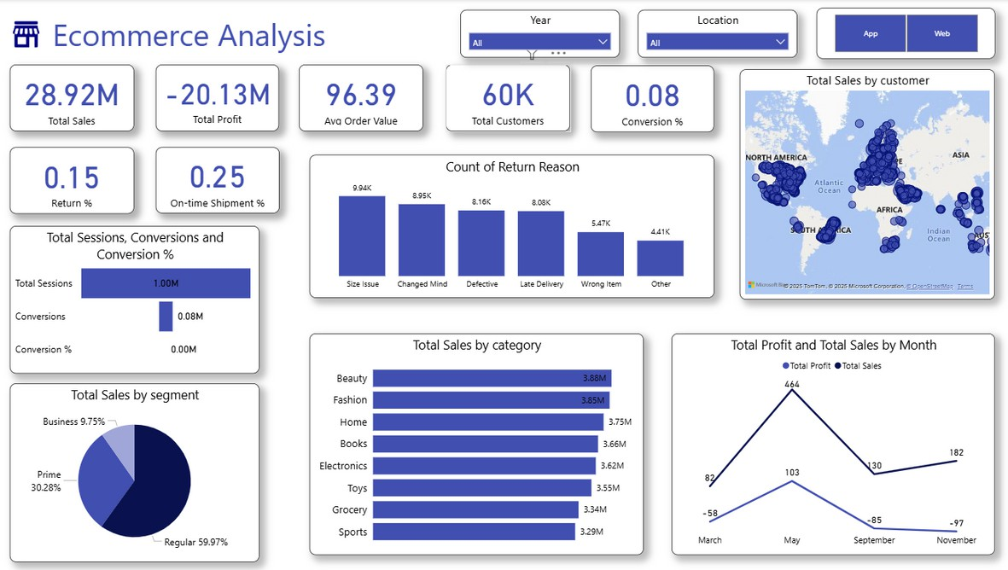
POWER BI DASHBOARD
Sales: ₹28.9M | Profit: –₹20.1M | Customers: 60K
Returns: 15% | On-time Shipments: 25% | Conversion: 0.8%

Slide 7
KEY BUSINESS INSIGHTS
Beauty & Fashion top categories (~₹3.8M each). Prime customers contribute ~30% revenue.
Size Issue & Changed Mind → 40%+ returns. Only 25% shipments on-time → logistics gap.
Funnel leakage: 1M sessions → only 0.8% convert.

Slide 8
RECOMMENDATIONS
Improve logistics performance → target 90% on-time delivery. Address return reasons → size guide, product descriptions, quality checks.
Optimize digital funnel → A/B testing, UI/UX improvements, personalized offers.
Strengthen Prime customer loyalty → exclusive offers, rewards. Expand high-performing categories → Beauty and Fashion.

